Slide 1
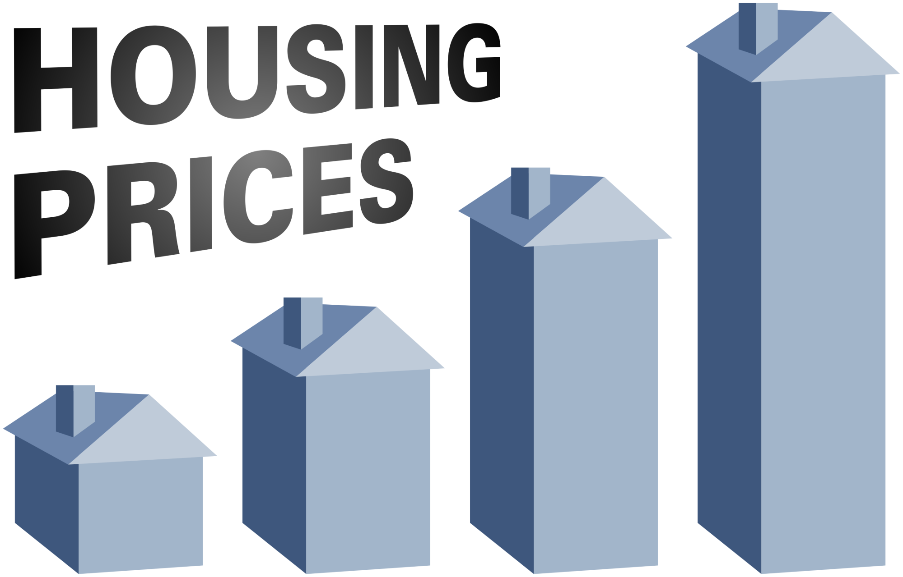

COST TREND ANALYSIS OF HOUSING PRICES IN MASSACHUSETTS (2008-16) USING MINITAB
Presented by:
Nishit Shah Rohit appandaraju
Ajit manuel

Slide 2
BRIEF OVERVIEW
Investors
Mortgage Lenders
Home Owners

Slide 3
HOW WE DID IT
We interview Fortune 100 executives & read 100s of editorials ― and only email you the insights and resources that will help you develop your career. All, in a brief report so you can stay ahead of the curve.
D
Root Cause Analysis:
Identified the factors responsible for price variation.
C
Data Analysis:
Analyzed yearly changes in price to determine root cause for price variation.
B
Sorted Data:
Calculated yearly mean price for every city.
A
Retrieved Data:
Collected monthly data of
housing prices for selected cities from 2008 to 2016.

Slide 4
P DIAGRAM
Control Factors
Recession
Taxes
Globalization
Industrialization
Output
Identified Major
Factors affecting price variation.
Input
Housing Prices
Process
Root Cause Analysis
xxxxx
Noise Factors
Natural Disasters
Competitiveness of neighboring cities
Crime rate

Slide 5
TIME SERIES

Slide 9
ANOVA for Housing Prices
Analysis of Variance
Source DF Adj SS Adj MS F-Value P-Value
Factor 2 2.22009E+11 1.11005E+11 52.92 0.000
Error 24 50339336296 2097472346
Total 26 2.72349E+11
Model Summary
S R-sq R-sq(adj) R-sq(pred)
45798.2 81.52% 79.98% 76.61%

Slide 10
FACTORS DISCOVERED
Investors buying Mortgage backed securities from financial institutions and earning millions from mortgage payments by home-owners.
As mortgage payments increases, number of defaulters increase and banks along with investors suffers credit crisis. To recover the loss, investors puts houses on sale,but due to increased prices, supply of houses is more and demand is less.
High supply and low demand leads to decreased house prices. Atlast, federal funds help bail out financial institutions.
Banks selling sub-prime mortgages to earn more and eventually investors earn more, hence housing prices balloons up.

Slide 11
RETROSPECTIVE
LESSONS LEARNED
How our analysis will help people and organizations
How government and realtors are affected
HOW PEOPLE ARE AFFECTED

Slide 12

Questions

